Slide 1
Chemistry Learning Check Questions
2017-2018

Slide 2
Learning Map
1
2
3
4
5
6
7
8
9
10
11
12
13
14
15
16
17
18
19
20
21
22
23
24
25
26
27
28
29
30
31
32
33
34
35
36
37
38
39
40
41
42
43
44
45
46
47
48
49
50
51
52
53
54
55
56
57
58
59
60
61
62
63
64
65
66
67
68
69
70
71
72
73
74
75
76
77
78
79
80
81
82
83
84
85
86
87
88
89
90
91
92
93
94
95
96
97
98
99
100
101
102
103
104
105
106
107
108
109
110
111
112
113
114
115
116
117
118
119
120
121
122
123
124
125
126
127
128
129
130
131
132
133
134
135
136
137
138
139
140
141
142
143
144
145
146
147
148
149
150
151
152
153
154
155
156
157
158
159
160
161
162
163
164
165
166
167
168
169
170
171
172
173
174
175
176
177
178
179
180
181
182
183
184
185
186
187
188
189
190
191
192
193
194
195
196
197
198
199
200
201

Slide 3
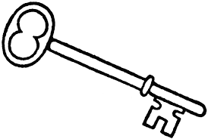

#1
If you are in lab and have longer hair, what should you do with it?

Slide 4
#1
Keep all long hair pulled back and tied

Slide 5
#2
What kind of clothes should you not wear in a science lab?

Slide 6
#2
Loose clothing- especially sleeves!
Open toed shoes

Slide 7
#3
What do you do if your lab partner catches on fire?

Slide 8
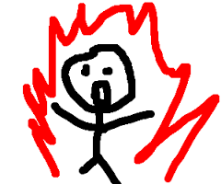
#3
Wrap them in the fire blanket and pat them!
OR
Stop, Drop, and Roll!

Slide 9
#4
How do you protect your eyes during labs?

Slide 10
#4
Wear eye protection (goggles)!

Slide 11
#6
How do you smell chemicals in Chemistry lab?

Slide 12

#6
WAFT IT!

Slide 13
#5
When heating or mixing a test tube, what must you remember?

Slide 14
#5
Angle it away from you and your partner’s faces

Slide 15
#7
How should you behave for safety during labs?

Slide 16
#7
PAY ATTENTION- “Lab Defensively”

Slide 17
#8
What is a beaker and what is it used for in a lab?

Slide 18
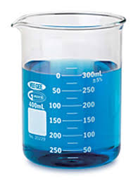

#8
Used for holding liquids as it is not precise in measuring

Slide 19
#9
What does an Erlenmeyer flask look like?

Slide 20
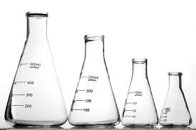
#9
This is a family of Erlenmeyer flasks

Slide 21
#10
What does a graduated cylinder look like and what is it used for?

Slide 22
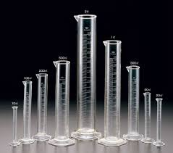
#10
This is a family of graduated cylinders, they are used for measuring volumes of liquids

Slide 23
#11
What does a test tube look like?

Slide 24
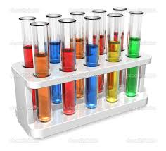
#11
This is a family of test tubes

Slide 25
#12
What does a Bunsen Burner look like and what is it used for?

Slide 26
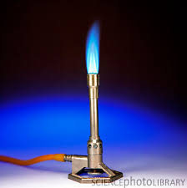
#12
Bunsen Burner is used for heating substances with flame!

Slide 27
#13
What is the purpose of the background in the scientific method?

Slide 28
#13
Background is where you include prior knowledge or research for your investigation

Slide 29
#14
What should be included in a research question or problem statement to make it testable?

Slide 30
#14
Both responding and manipulated variables

Slide 31
#15
What is a hypothesis and what do you need to include?

Slide 32
#15
An educated guess where you state what you will be testing, what you think will happen and your reasoning.

Slide 33
#16
What should procedures include?

Slide 34
#16
Logical steps to be followed to test the question, with all materials and amounts included as well as variables

Slide 35
#17
What is the difference between quantitative and qualitative data?

Slide 36
#17
Quantitative data is numerical while qualitative data describes how a substance appears or behaves

Slide 37
#18
What are some forms of analysis of data?

Slide 38
#18
Graphs, calculations, and reflective questions about the data.

Slide 39
#19
What should be included in a conclusion?

Slide 40
#19
A claim, evidence and reasoning (CER) for what happened, discussion of hypothesis, discussion of precision and accuracy of data, real world application and a new question to be tested.

Slide 41
#20
How do we know what type of units to use when making measurements?
What is the unit for Energy?
What is the SI unit for Pressure?
What is the SI unit for Temperature?

Slide 42
#20
We follow the International System of Units (SI Units).
Energy= Joules (J)
Pressure= Pascals (Pa)
Temperature= degrees Celcius (˚C) Or Kelvins (K)

Slide 43
#21
In the metric system, what do the prefixes Kilo, hecto, deca, base unit, deci, centi, milli, micro and nano stand for (according to powers of 10)?

Slide 44
#21
kilo (1,000 or 10³)
hecto (100 or 10²)
deca (10 or 10¹)
base unit (1
deci (.1 or 10⁻¹)
centi (.01 or 10⁻²)
milli (.001 or 10⁻³)
micro (.ooooo1 or 10⁻⁶)
nano (.000000001 or 10⁻⁹)

Slide 45
#22
In the metric system, what are the symbols for the prefixes for Kilo, hecto, deca, deci, centi, and milli, micro and nano?

Slide 46
#22
kilo =K
hecto =h
deca =da
deci =d
centi =c
milli =m
micro=μ
nano=n

Slide 47
#23
In Scientific Notation, how does writing really large numbers differ from writing really small (decimal) numbers?

Slide 48
#23
Large Numbers have positive exponents (100,000 = 10⁵)
Decimal numbers have negative exponents (.0001 = 10⁻⁴)

Slide 49
#24
How are metric conversions set up?

Slide 50
#24
Using dimensional analysis or factor label method to cancel units until desired unit is achieved.

Slide 51
#25
How do you make and record a measurement effectively?

Slide 52
#25
Use the appropriate scientific tool, record with the correct unit and make with appropriate precision for tool being used.

Slide 53
#26
In Scientific Notation, are all non zero digits considered “significant”?

Slide 54
#26
Yes!

Slide 55
#27
Is a zero significant if it is found between non-zero digits?

Slide 56
#27
Yes!

Slide 57
#28
In counting significant digits, how could a zero on the right side of the decimal be significant?

Slide 58
#28
If it was at the end of the number or sandwiched between other significant numbers.

Slide 59
#29
When adding and subtracting, what significant figures do you count to determine proper number to include in answer?

Slide 60
#29
Only the ones on the right side of the decimal.

Slide 61
#30
When multiplying and dividing, what significant figures do you count to determine proper number to include in answer?

Slide 62
#30
The total number of significant figures in each original number.

Slide 63
#31
What is matter?
What is NOT matter?

Slide 64
#31
Anything that has mass and volume.
Energy is not matter.

Slide 65
#32
What is mass and how is it measured?

Slide 66
#32
Mass is the amount of matter contained in something and is measured (on Earth) using grams

Slide 67
#33
What is volume and how is it measured?

Slide 68
#33
Volume is the amount of space that an object occupies
Liquids- milliliters
Solids- cubic centimeters (cm³)

Slide 69
#34
What is density and how is it measured?

Slide 70
#34
Density is the amount of matter contained in a certain amount of space in g/mL or g/cm³

Slide 71
#35
What are physical properties?

Slide 72
#35
Properties that are observable and measureable (uses 5 senses!) and can be determined without substance becoming something new.

Slide 73
#36
What are chemical properties?

Slide 74
#36
Characteristics that describe the possible chemical changes of matter and can only be determine when a substance becomes something new.

Slide 75
#37
What are Extensive Physical properties?

Slide 76
#37
Characteristics that you can measure that depends on the size or amount of the matter (weight, volume, etc)

Slide 77
#38
What are Intensive Physical properties?

Slide 78
#38
Characteristics of a substance that do NOT depend on the size or amount of the matter (density, color, conductivity, etc)

Slide 79
#39
What is Kinetic Theory?

Slide 80
#39
Kinetic Theory is the idea that all atoms are in constant motion (even solids!)

Slide 81
#40
Distinguish between a solid, liquid, and gas

Slide 82
#40
Solid= definite shape and volume (least energy)
Liquid= No definite shape but definite volume
Gas= No definite shape or volume (highest energy)

Slide 83
#41
How can you move matter from one phase to another? (i.e. from solid to liquid)

Slide 84

#41
Add or remove Energy!

Slide 85
#42
What is the transition from solid to liquid called?
What is the transition from liquid to solid called?
What is the transition from liquid to gas called?
What is the transition from gas to liquid called?
What is the transition from gas to solid called?
What is the transition from solid to gas called?

Slide 86
#42
Melting
Freezing or solidification
Vaporization
Condensing
Deposition
Sublimation

Slide 87
#43
How is a vapor different from a gas?

Slide 88
#43
A vapor is the gas phase of matter that is normally liquid at room temp (like water vapor)
Gas is something that is gas at room temp (like CO2 gas)

Slide 89
#44
What is an element?

Slide 90
#44
A pure substance made of only one type of atom.

Slide 91
#45
What is a compound?

Slide 92
#45
A pure substance made of two or more types of atoms bonded together.

Slide 93
#46
What is a mixture of one or more pure substances that is uniform in composition and transparent?

Slide 94
#46
A homogeneous solution

Slide 95
#47
What is a mixture of one or more pure substances that is uniform in composition and opaque?

Slide 96
#47
A homogeneous suspension

Slide 97
#48
What is a heterogeneous mixture?

Slide 98
#48
A mixture of one or more pure substances that is not uniform in composition.

Slide 99
#49
How can you determine a physical change has occurred in a substance?

Slide 100
#49
When the structure of the substance changes but not the identity. Intermolecular forces are modified.

Slide 101

#50
How can you determine if a chemical change has occurred in a substance?

Slide 102
#50
When a substance changes into a new substance. Intramolecular forces are modified.

Slide 103
#51
What is the smallest, discrete unit of matter?

Slide 104
#51
Atoms!

Slide 105
#52
What is the structure of an atom?

Slide 106
#52
An atom has a nucleus that contains protons and neutrons and is surrounded by electrons found in energy levels (electron cloud)

Slide 107
#53
What are the charges of protons, electrons, and neutrons?

Slide 108
#53
Protons are +
Electrons are –
Neutrons are 0 (neutral)

Slide 109
#54
What particles are considered in the mass of an atom?
What are the masses of protons, neutrons, and electrons?

Slide 110
#54
Protons and neutrons only- electrons are too small to contribute!
Protons= 1 amu (atomic mass unit)
Neutrons= ~1 amu
Electrons= 0.0005 amu

Slide 111
#55
What is an isotope?

Slide 112
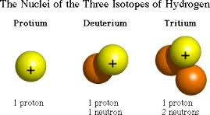
#55
An isotope is an atom of the same element but with a different # of neutrons so its mass is slightly different

Slide 113
#56
What is average atomic mass and how is it calculated?

Slide 114
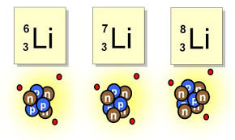
#56
Average atomic mass is the average mass of an atom of an element.
Isotopes can affect this number- Relative abundance of isotopes vs. their mass help calculate this average

Slide 115
#57
What is the name of the Ancient Greek gentleman who first came up with the concept of an atom?

Slide 116
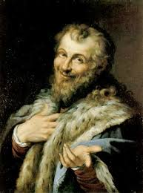
#57
Democritus

Slide 117
#58
Who proposed the “Atomic Theory”- 4 key ideas that impact how we understand Matter and Chemistry today?

Slide 118
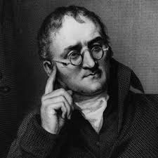
#58
John Dalton

Slide 119
#59
Who was Dmitri Mendeleev and what did he contribute to Atomic Theory?

Slide 120
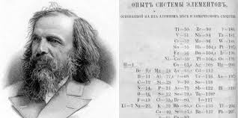
#59
Dmitri Mendeleev constructed a Periodic Table that led to our modern one!

Slide 121
#60
Who used cathode rays to discover electrons?

Slide 122
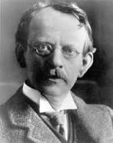
#60
J.J. Thomson

Slide 123
#61
Who discovered the elements Radium and Polonium?

Slide 124
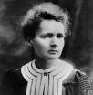
#61
Marie and Pierre Curie!

Slide 125
#62
Who developed the idea of “quanta”, the unit of Energy related to the frequency of a wave?

Slide 126
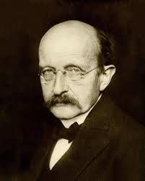
#62
Max Planck

Slide 127
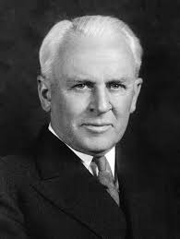
#63
What experiment did R.A. Millikan use to discover the mass of an electron?

Slide 128
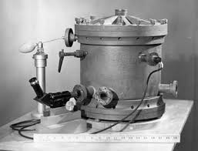
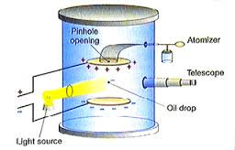
#63
Oil Drop Experiment!

Slide 129
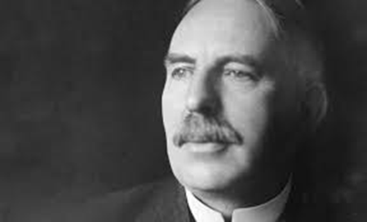
#64
What was Ernest Rutherford’s contribution to Atomic Theory and what experiment is he famous for?

Slide 130
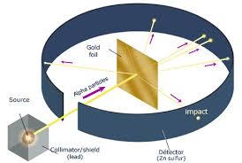
#64
Ernest is famous for discovering the nucleus of the atom and the positive protons inside of it! He used the Gold Foil Experiment to support his hypothesis

Slide 131
#65
Who hypothesized that electrons orbited the nucleus of the atom just like the planets orbit the sun? (turns out, not correct)

Slide 132
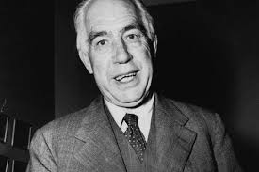
#65
Neils Bohr

Slide 133
#66
Who discovered the neutron using alpha particles?

Slide 134
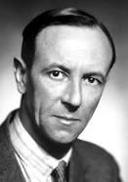
#66
James Chadwick!

Slide 135
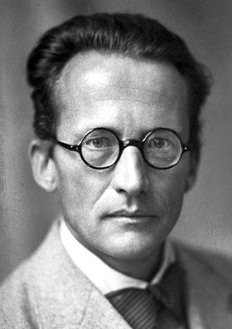
#67
What did Ernest Shrodinger contribute to the atomic theory?

Slide 136
#67
Used his equation to explain wave nature of electrons that led to quantum mechanic model of atom.

Slide 137
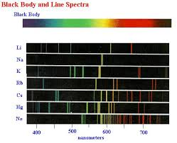
#68
Why do elements give off their own atomic emission spectrum if one adds energy?

Slide 138
#68
Atoms will emit their own atomic emission spectrum when Energy is added because their electrons give off light as they fall back down from higher to lower energy levels

Slide 139
#69
What is the Electromagnetic Spectrum?

Slide 140
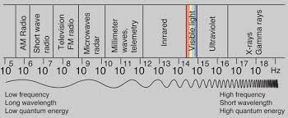
#69
The Electromagnetic Spectrum is the broad range of frequencies emitted by electromagnetic radiation

Slide 141
#71
How do you measure a complete wavelength, what is the symbol for wavelength and what unit is it measured in?

Slide 142
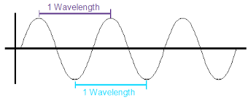
#71
From crest to crest or trough to trough, symbol is λ and it is measured in meters

Slide 143
#70
How does electromagnetic radiation move through space?

Slide 144
#70
In waves!

Slide 145
#72
What is the frequency of a wave? What is the symbol for frequency and what unit is it measured in?

Slide 146
#72
Frequency is the amount of complete waves that occur every second
Symbol is ν
Hertz! (Hz=1/s=1s⁻¹)

Slide 147
#73
What is the speed of light and what is it’s symbol?

Slide 148
#73
Speed of light (c)= 3.0 X 10⁸ m/s

Slide 149
#74
What formula relates frequency to wavelength?

Slide 150
#74
C = λ ν

Slide 151
#75
What colors are on the visible light section of the Electromagnetic Spectrum- least to greatest frequency?

Slide 152
#75
ROYGBIV!
Least----→ Greatest

Slide 153
#76
What is the Photoelectric Effect?

Slide 154
#76
The photoelectric effect explains when metals emit electrons when light shines on them

Slide 155
#77
What is the relationship of the frequency of an electron compared to its Energy?

Slide 156
#77
Directly related because the formula is:
E= hν
E= Energy
h= Planck’s Constant (6.626 X 10⁻³⁴ Joules seconds)
ν= frequency

Slide 157
#78
What is Fission?

Slide 158
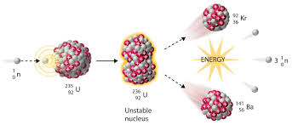
#78
Fission is a process where the nucleus splits into smaller nuclei and free neutrons

Slide 159
#79
What is Fusion?

Slide 160
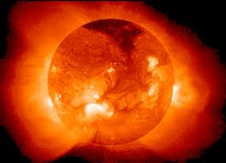
#79
Fusion is a process where the nucleus of an atom fuses with the nucleus of another to form a new and heavier element (this is how stars create new elements!)

Slide 161
#80
What are the forms of radioactive decay?

Slide 162
#80
Alpha, beta and gamma

Slide 163
#81
How is the Periodic Table organized (primarily)?

Slide 164
#81
In order of increasing Atomic # (# of protons!)

Slide 165
#82
What does the atomic number tell us about an element?

Slide 166
#82
The number of protons (and the initial number of electrons)

Slide 167
#83
What does the Period # (row) of an atom tell us?

Slide 168
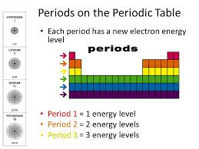
#83
The number of energy levels that atom has!

Slide 169
#84
Why are valence electrons important, specifically?

Slide 170
#84
Valence electrons are in the outer most energy level of an atom and they contribute to an atom’s chemical properties such as Bonding!

Slide 171
#85
What does an element’s group # tell you?

Slide 172
#85
The group number is the number of
Valence electrons and
The Family #- all elements in a family have similar properties and behaviors

Slide 173
#86
What is the name of the family in Group 1A?
What is the name of the Family in Group 2A?
What is the name of the Family in Group 6A?
What is the name of the Family in Group 7A?
What is the name of the Family in Group 8A?
What is the name of the Family in Group 1B-8B?

Slide 174
#86
Alkali metals
Alkaline Earth metals
Chalcogens
Halogens
Noble Gases
Transition metals

Slide 175
#87
What are some chemical properties of alkali metals?

Slide 176
#87
Highly reactive with water and reactivity increases DOWN the family

Slide 177
#88
What are some characteristics of the Halogen Family?

Slide 178
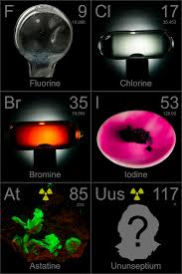
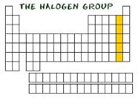
#88
Halogen (Group 7) are mainly gases and are highly reactive! Their reactivity increases as you go UP the family- Fluorine is the most reactive!

Slide 179
#89
Why are noble gases so unreactive?

Slide 180
#89
Noble gases do not react with other atoms because they have a full outer (valence) shell/energy level

Slide 181
#90
What are some properties of metals?

Slide 182
#90
Solids, shiny, high density, high m.p., conduct electricity, malleable, ductile

Slide 183
#91
What does Malleability and Ductility mean?

Slide 184
#91
Malleable- Can be pressed or pounded easily
Ductile- Can be pulled thin into a wire

Slide 185
#92
On the Periodic Table, where would you find metals, non-metals, and metalloids?

Slide 186
#92
Metals- Left side (most of the table!)
Non Metals- Right side
Metalloids- Down Staircase separating metals from nonmetals

Slide 187
#93
What is Electronegativity?

Slide 188
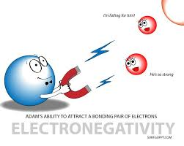
#93
Electronegativity is the amount of attraction an atom has to pull electrons to itself (it will take it from another atom to form an anion)

Slide 189
#94
What is the trend on the periodic table for Electronegativity?

Slide 190
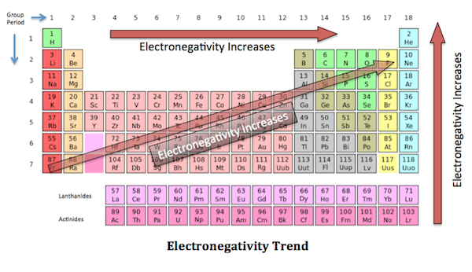
#94

Slide 191
#95
What is Ionization Energy?

Slide 192
#95
The amount of Energy needed to take away an atom’s electron, which causes it to form a cation

Slide 193
#96
On the Periodic Table, what is the general trend for Ionization Energy?

Slide 194
#96
Ionization energy increases across the P. Table from left to right and increases as you go up the group

Slide 195
#97
What is the trend for melting points on the Periodic Table?

Slide 196
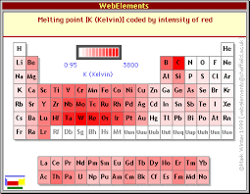
#97
Melting points tend to increase as you go up a group and will increase in the middle of the table

Slide 197
#98
What is the trend for atomic radius on the Periodic Table?

Slide 198
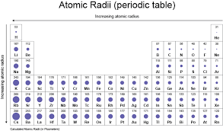
#98
Atomic Radius increases…

Slide 199
#99
Most property trends on the periodic table are influenced by what two factors?

Slide 200
#99
Nuclear charge (number of protons) and electron shielding

Slide 201
#100
Which 7 elements are Diatomic (exists as a two atom molecule when pure in nature)?

Slide 202
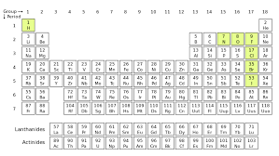
#100
Hydrogen- H₂
Oxygen- O₂
Nitrogen- N₂
Fluorine- F₂
Chlorine- Cl₂
Bromine- Br₂
Iodine- I₂

Slide 203
#101
What does a Chemical Formula tell you?

Slide 204
#101
It tells you which elements and how many of each of those atoms
2 Hydrogen, 1 Oxygen- H₂O

Slide 205
#102
In a compound, what does the subscript mean?

Slide 206
#102
The subscript tells you how many atoms of that element there are
Ex: C₆H₁₂O₆
6 Carbon, 12 Hydrogen, 6 Oxygen

Slide 207
#103
In a compound, what does the subscript OUTSIDE of a parentheses mean?
i.e. Ca(OH)₂

Slide 208
#103
The subscript outside applies to all of the atoms inside of the parentheses!
i.e. Ca(OH)₂
_{1 Calcium 2 Oxygen 2 Hydrogen}

Slide 209
#104
In a compound, what does the coefficient (number in front) mean?

Slide 210
#104
The coefficient tells you how many of that compound you have:
2 O₂→ 2 Oxygen molecules
5 C₆H₁₂O₆→ 5 Glucose Molecules

Slide 211
#105
What is the quantity of a mole?

Slide 212
#105
A mole is 6.022 X 10²³ particles of any substance

Slide 213
#106
What is the mass of one mole of an atom or compound?

Slide 214
#106
The mass can be measured by using the listed atomic mass from the P.T. in grams
Lithium’s mass is 6.941 amu so the mass of
1 mole of Li is 6.941 grams

Slide 215
#107
How do you calculate the total mass (formula mass) of a compound such as NaCl?

Slide 216
#107
Add the atomic masses of ALL atoms in the compound!
NaCl is
Na (23amu) + Cl (35amu) =
58 amu total!

Slide 217
#108
What is the “Octet Rule”?

Slide 218
#108
The “Octet Rule” states that atoms try to fill their valence shells to reach 8 electrons (this drives the need to bond!)

Slide 219
#109
How can you predict the reactivity of an atom?

Slide 220
#109
An atom’s reactivity is related to how far (or close) it’s valence shell is from an octet (8 electrons!) and how far those elctrons are from the nucleus

Slide 221
#110
What type of bonds do metals and nonmetals form with each other?

Slide 222
#110
Ionic bonds

Slide 223
#111
What type of bonds will nonmetals form with other nonmetals?

Slide 224
#111
Covalent bonds

Slide 225
#112
How do ionic bonds form?

Slide 226
#112
When opposite charged ions attract to each other after one elements takes the valence electrons of another element to form two oppositely charged ions.

Slide 227
#113
How do covalent bonds form?

Slide 228
#113
When elements share their valence electrons to reach an octet.

Slide 229
#114
How are metallic bonds formed?

Slide 230
#114
Metallic bonds form as the result of delocalized electrons that free flow around metallic cations

Slide 231
#115
What are 2 characteristics of metallic compounds and what allows them to have that?

Slide 232
#115
Strong
Malleable
Ductile
Conducts Electricity
Conducts Heat
All caused by free flowing electrons

Slide 233
#116
What is an ion?

Slide 234
#116
An ion is an atom with a charge because it has lost (+ion) or gained (-ion) electrons

Slide 235
#117
What ions do metals usually form?

Slide 236
#117
Metals form cations which are positively charged ions because it LOST electrons. The number of electrons lost determines the number (Ca²⁺ = Calcium lost 2 electrons)

Slide 237
#118
What is an anion and what usually forms them?

Slide 238
#118
An anion is a negatively charged atom because it GAINED electrons. The number of electrons gained determines the number (Br¹⁻ = Bromine gained 1 electron). Non metals gain electrons to form them.

Slide 239
#119
What happens when two opposite charges interact?

Slide 240

#119
They attract ☺

Slide 241
#120
What happens when you put two of the same charges together? Such as a positive next to a positive?

Slide 242
#120
They repel each other.

Slide 243
#121
Describe the difference in Electronegativities for Ionic Compounds.

Slide 244
#121
Ionic Compounds have LARGE differences (>1.7) between the electronegativities of the atoms

Slide 245
#122
Describe the difference in Electronegativities for Covalent Compounds.

Slide 246
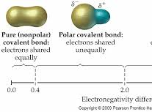
#122
Covalent compounds have smaller (0.4<x<1.7) differences for polar covalent and no differences (<0.4) for non-polar covalent

Slide 247
#123
What are 2 properties of ionic compounds?

Slide 248
#123
Ionic compounds have high melting points, are soluble in water, and can conduct electricity as liquids

Slide 249
#124
What are 2 properties of covalent compounds?

Slide 250
#124
Covalent compounds have relatively low melting points, are soluble in water if they are polar, and do not conduct electricity.

Slide 251
#125
What are the names for the prefixes used in naming molecular compounds and what do they tell you?
1,2,3,4,5,6,7,8,9,10?

Slide 252
#125
1- mono, 2- di, 3-tri, 4- tetra,
5-penta, 6-hexa, 7-hepta, 8-octa, 9-nona, 10-deca
They tell you how many of that atom are in the molecule formula
CO₂- Carbon dioxide

Slide 253
#126
In naming molecular compounds, what do the names end with?

Slide 254
#126
They end in “ide”

Slide 255
#127
How are ionic compounds named?

Slide 256
#127
Ionic compounds simply list the ions present (cation first):
Na+ Sodium
Cl- Chloride
“Sodium chloride”

Slide 257
#128
In an ionic compound, what order do you list the cation (positive ion)?

Slide 258
#128
The cation is always first
Iron oxide (2 Fe ³⁺+ 3 O²⁻ →Fe₂O₃)
Lead sulfide (Pb ²⁺+ 2 S¹⁻ → PbS₂)
Aluminum chloride
(Al ³⁺+ 3 Cl¹⁻ → AlCl₃)

Slide 259
#129
In naming an ionic compound, what ending do you put on the end of single negative ions (anions)?

Slide 260
#129
It will end in –IDE
Iron oxide (2 Fe ³⁺+ 3 O²⁻ →Fe₂O₃)
Lead sulfide (Pb ²⁺+ 2 S¹⁻ → PbS₂)
Aluminum chloride
(Al ³⁺+ 3 Cl¹⁻ → AlCl₃)

Slide 261
#130
What is a polyatomic ion and how do you name it?

Slide 262
#130
It’s a charged particle that is made of more than one element like, NO₃¹⁻
It’s name is determined by looking at the periodic table of ions!
NO₃¹⁻ is Nitrate

Slide 263
#131
What kind of bonds hold polyatomic ions together?
Like Sulfate- SO₄²⁻

Slide 264
#131
Polyatomic ions are bonded together with COVALENT bonds
Right?
SO₄²⁻
S- nonmetal, O- nonmetal = Covalent!

Slide 265
#132
How do you find the Percent Composition of a specific element in the total compound?

Slide 266
#132
Divide the mass of the element by the mass of the whole compound and then multiplying by 100
mass of Na X 100 = ___%
mass of NaCl

Slide 267
#133
What is the Empirical Formula of a compound?

Slide 268
#133
The Empirical Formula is the smallest ratio of elements in a compound
C₆H₁₂O₆- E.F. is CH₂O

Slide 269
#134
What is the Molecular Formula of a compound?

Slide 270
#134
The Molecular Formula is a multiple of the Empirical Formula
M.F.= C₆H₁₂O₆
(E.F. is CH₂O)

Slide 271
#135
What is the VSEPR Theory?

Slide 272
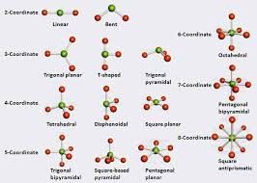
#135
The Valence Shell Electron Pair Repulsion Theory states that electrons (-) repel each other and so will push away from each other and be as far away as possible from each other as possible- this will influence the SHAPE of the molecule!

Slide 273
#136
What is a lone pair on an atom?

Slide 274
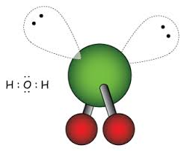
#136
A lone pair of electrons on an atom are paired valence electrons that do not bond with other atoms- they affect the shape of the molecule

Slide 275
#137
What is a polar covalent compound?

Slide 276
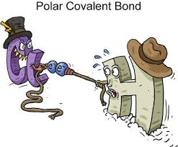
#137
A covalent compound where the atoms do not share the electrons equally

Slide 277
#138
What is a nonpolar molecules?

Slide 278
#138
Nonpolar molecules are molecules with no overall charge because they either
1)Have equal electronegativities or
2) Are symmetrical

Slide 279
#139
What is a major difference between polar and non-polar molecules?

Slide 280
#139
Polar molecules will dissolve in water and conduct electricity slightly. Non-polar ones will not dissolve in water and do not conduct electricity

Slide 281
#140
What is a solution? What is a solute and what is a solvent?

Slide 282
#140
Solution- A liquid mixture where one substance is dissolved into another (lemonade)
Solute- The substance(s) that was/were dissolved (lemon, sugar)
Solvent- The substance that did the dissolving (water)

Slide 283
#141
What do polar and nonpolar compounds dissolve in?

Slide 284
#141
Like dissolves like!
Polar compounds dissolve in polar liquids (i.e. NaCl in H2O)
Nonpolar compounds dissolve in nonpolar liquids (i.e. Glycerol in Alcohol)

Slide 285
#142
What type of compound is water? What types of substances will dissolve in water?

Slide 286
#142
Water is a polar covalent compound that will dissolve other polar substances as well as many ionic compounds.

Slide 287
#143
What are the names of the words that describe the tendency for water to stick to a) itself and b)other compounds?

Slide 288
#143
Cohesion
Adhesion

Slide 289
#144
What is chromatography?

Slide 290
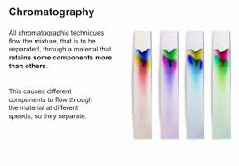
#144
Chromatography is the separation of substances based on their molecular sizes ( usually as they moved as a liquid across a substrate like paper)

Slide 291
#145
What does conductivity mean?

Slide 292
#145
A substance’s ability to allow electricity or heat to pass through itself

Slide 293
#146
What are intramolecular forces?

Slide 294
#146
Intramolecular forces are the bonds that hold a compound together from WITHIN (such as ionic bonds or covalent bonds)

Slide 295
#147
What are intermolecular forces?

Slide 296
#147
Intermolecular forces are weak forces that cause a slight attraction between 2 different compounds such as dipole-dipole
(like interstate connects 2 different states)

Slide 297
#148
Which is stronger, Intramolecular forces or Intermolecular forces?

Slide 298
#148
Intramolecular are stronger

Slide 299
#149
Between what type of molecules would you find dipole-dipole interactions?

Slide 300
#149
Two polar molecules

Slide 301
#150
For intermolecular forces, how do you recognize Hydrogen bonds?

Slide 302
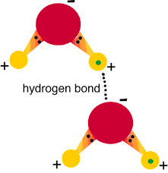
#150
Hydrogen bonds are an extra strong dipole-dipole interaction that involves Hydrogen!
H-N
H-F
H-O

Slide 303
#151
What are London dispersion (Van der Waal’s forces)?

Slide 304
#151
London Dispersion forces are the slight attraction that occurs between two nonpolar molecules

Slide 305
#152
What compounds undergo dipole-induced intermolecular forces?

Slide 306
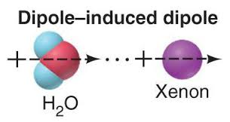
#152
A polar molecule with a non-polar molecule

Slide 307
#153
Which will evaporate more quickly, compounds with weaker intermolecular bonds or compounds with stronger intermolecular bonds ?

Slide 308
#153
Compounds with weaker intermolecular forces will evaporate more quickly.

Slide 309
#154
In a chemical reaction, define reactants and products? Where are they each written in a chemical equation?

Slide 310
#154
Reactants= The initial chemicals involved in a reaction and are written on the left side of the equation
Products= The resulting chemicals that are present when a reaction is completed and are written on the right side of the equation

Slide 311
#155
What does the arrow in a chemical equation mean?

Slide 312
#155
The arrow means yields or produces

Slide 313
#156
What is Theoretical Yield?

Slide 314
#156
The expected amount of product that will form at the end of a reaction (usually calculated in grams)

Slide 315
#157
What is the actual yield in an experiment?

Slide 316
#157
Actual yield is the amount of product that was actually produced at the end of an experiment

Slide 317
#158
What is percent yield and how is it calculated?

Slide 318
#158
The percent yield tells you the percentage of how much product you created
% yield = actual yield X 100
theoretical yield

Slide 319
#159
What is the percent error?

Slide 320
#159
Percent error is the amount of error associated with your actual yield compared to the theoretical one
% error = theo-actual yield X 100
theoretical yield

Slide 321
#160
What is the Law of Conservation of Energy?

Slide 322
#160
Energy is never created or destroyed, it only changes form

Slide 323
#161
What is the Law of Conservation of Mass?

Slide 324
#161
The total mass of a system is always conserved
Or,
In a Chemical Rxn, the mass of the reactants is the same as the mass of the products

Slide 325
#162
What makes a chemical equation “Balanced”?

Slide 326
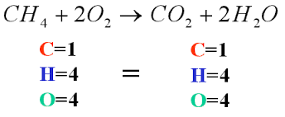
#162
The number of atoms on the Reactant side must equal the number of atoms on the Product side

Slide 327
#163
How do you balance a chemical equation?

Slide 328
#163
To balance an equation you can only add a coefficient to the FRONT of a compound to make sure there are the same amount of atoms on both sides of the equation
Ex: 2 H₂ + O₂ → 2 H₂O

Slide 329
#164
What are the five main types of chemical reactions?

Slide 330
#164
Combination Reaction
Decomposition Reaction
Combustion Reaction
Single Displacement Reaction
Double Displacement Reaction

Slide 331
#165
What is a combustion reaction?

Slide 332
#165
Fuel + O₂ → CO₂ + H₂O

Slide 333
#166
What is a combination reaction?

Slide 334
#166
A Combination Reaction is when two reactants combine to form one product

Slide 335
#167
What happens in a decomposition reaction?

Slide 336
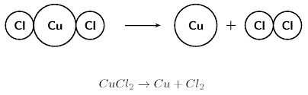
#167
A Decomposition Reaction is when one large reactant will break down into smaller products

Slide 337
#168
What happens in a single displacement reaction?

Slide 338
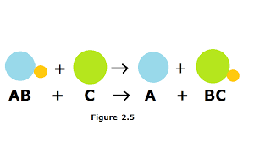
#168
A compound and element will react to form a different compound and different element (a switcheroo!)

Slide 339
#169
What happens in a double displacement reaction?

Slide 340

#169
Two compounds will react to form two different compounds (a double switcheroo!)

Slide 341
#170
What is a precipitate reaction?

Slide 342
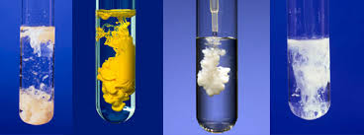
#170
A precipitate will form if a product of two reacting chemicals is not soluble in water- it will “fall” out of solution

Slide 343
#171
What is an aqueous solution?

Slide 344
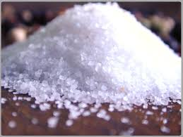
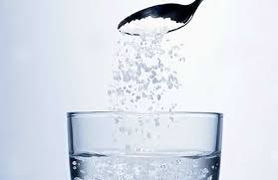
#171
A solution created when a solid is dissolved in water
NaCl (s)
NaCl(aq)

Slide 345
#172
What is a precipitate?

Slide 346
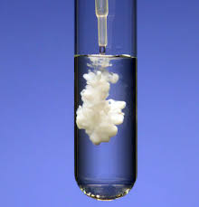
#172
A precipitate is a solid product that falls out of solution as the result of a chemical reaction

Slide 347
#173
What does the Molarity of a Solution mean?

Slide 348
#173
Molarity (M) of a solution is equal to the number of moles of a substance dissolved in 1 Liter of solution

Slide 349
#174
In a chemical reaction, what is the limiting reagent?

Slide 350

#174
The limiting reactant in a chemical reaction is the reactant that runs out first.

Slide 351
#175
What is the rate of a reaction?

Slide 352
#175
The rate of a reaction is how much time it takes for the reaction to be completed from start to finish

Slide 353
#176
What factors affect the rate of reaction?

Slide 354
#176
Reaction rate will increase if temperature, concentration increases or particle size decreases.

Slide 355
#178
What does Le Chatelier’s Principle state?

Slide 356
#178
Le Chatelier’s Principle says if you change the conditions of the reactants in a Chem Rxn to disrupt equilibrium, then the rxn will change to readjust to a new equilibrium

Slide 357
#177
How is equilibrium reached in a chemical reaction?

Slide 358
#177
When the amount of reactants and products are such that there is no more net change of either.

Slide 359
#179
What is kinetic energy?

Slide 360

#179
Kinetic Energy is Energy in motion

Slide 361
#180
What is potential energy?

Slide 362

#180
The Energy Stored in a substance or System

Slide 363
#181
What is chemical energy?

Slide 364
#181
Chemical energy is the Potential Energy stored within the bonds of a chemical compound (they release when broken!)

Slide 365
#182
Is energy released or absorbed when bonds form?
Is energy released or absorbed when bonds break?

Slide 366
#182
Bonds Form = Energy Released
(Energy given off)
Bonds Break= Energy Absorbed (Energy needed to break them apart)

Slide 367
#183
Describe the energy movement (enthalpy) in an Exothermic Reaction.

Slide 368

#183
In an EXOthermic reaction, energy is released! The energy of the reactants is more than the products (enthalpy is negative)

Slide 369
#184
Describe the energy movement (enthalpy) in an Endothermic Reaction.

Slide 370

#184
In an ENDOthermic reaction, energy is absorbed! The energy of the reactants is less than the products (enthalpy is positive)

Slide 371
#185
What is Enthalpy?

Slide 372
#185
Enthalpy is the amount of heat released or absorbed in a reaction:
Exothermic- negative Enthalpy
Endothermic- postive Enthalpy

Slide 373
#186
What is the equation to describe Enthalpy- the total heat contained in a reaction?

Slide 374
#186
Enthalpy (H) is equal to Specific Heat of Substance (Cp) plus Pressure times Volume of substance
H = Cp + PV

Slide 375
#187
What is Specific Heat Capacity?

Slide 376
#187
The amount of energy required to raise the temp of 1 gram of a substance by 1 degree Celcius
Cp = q/ mass * Temp
Cp= Specific Heat
Q= heat Energy

Slide 377
#188
T or F:
When matter changes from one phase to another (such as gas to liquid), enthalpy will also change.

Slide 378
#188
True!
Enthalpy (total energy) will change when matter changes phase!

Slide 379
#189
What is Heat of Fusion?

Slide 380
#189
H_{fus} is the amount of energy needed to change a solid to a liquid

Slide 381
#190
What is the Heat of Vaporization?

Slide 382
#190
H_{vap} is the amount of energy needed to change a liquid to a gas

Slide 383
#191
What does Hess’s Law state?

Slide 384
#191
Hess’s Law says that the total enthalpy (heat energy) of a system is equal to the sum of ALL of the changes for the partial reactions

Slide 385
#192
What is the Change in Heat equation (enthalpy of formation Hf)?

Slide 386
#192
The Enthalpy of Formation (Hf)
is found by
Hf = ∆Hf,products - ∆Hf,reactants

Slide 387
#193
What does Calorimetry measure?

Slide 388
#193
The amount of energy found in substances measured by the amount of heat that is absorbed by water as the substance is burned (that’s how we know how many calories are in food!)

Slide 389
#194
Which has the most energy content stored in their bonds- fats, carbohydrates, or proteins?

Slide 390
#194
Fats have the most energy content, followed by proteins and carbohydrates.

Slide 391
#195
According to Boyle’s gas law, when the volume of a gas increases, the pressure ______?

Slide 392
#195
According to Boyle’s gas law, when the volume of a gas increases, the pressure decreases
(and vice versa!)

Slide 393
#196
What does Guy-Lussac’s Gas Law state?

Slide 394
#196
According to Guy-Lussac’s gas law, as the temp of a gas increases, so does the pressure
P1/T1 = P2/T2

Slide 395
#197
What does Charles’ Gas Law state?

Slide 396
#197
Charles’ Law states that the volume of gas is proportional to its temperature
V1/T1 = V2/T2

Slide 397
#198
What is the formula that describes all three gas laws combined?

Slide 398
#198
P₁V₁ = P₂V₂
T₁ T₂
P= Pressure
V= Volume
T= Temperature

Slide 399
#199
What does Avogadro’s Law of gases state?

Slide 400
#199
The Volume of a gas is proportional to the number of moles of a gas present (If the amount of gas increases, so does the volume of the gas)

Slide 401
#200
What is the volume of any gas at standard room temperature and pressure?

Slide 402
#200
ALL gases have a volume of 22.4L at STP

Slide 403
#201
What is the ideal gas law?

Slide 404
#201
PV=nRT
P=pressure
V=volume
n=moles
R=gas constant
T=temperature

