Slide 1
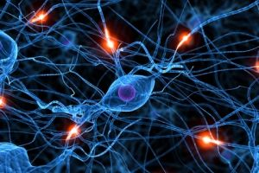
Cellular Communication

Slide 2
Chemical messages which elicit a response in cells serve as a form of communication between cells
Found in all cells
Similar in widely different organisms (such as humans and yeast) leads one to believe that this evolved very early in the history of life
Efficient signal transduction processes are generally under strong selective pressure, meaning if they work well the cell survives, if not, they die.

Slide 3
In single celled organisms…
Signal transduction pathways influence how the cell responds to it environment
  Use of chemical messengers by microbes to communicate with other nearby cells and to regulate specific pathways in response to population density
  Use of pheromones to trigger reproduction and developmental pathways
  Response to external signals by bacteria that influences cell movement

Slide 4
In multicellular organisms…
Signal transduction pathways coordinate the activities within individual cells that support the function of the organisms as a whole.
  Epinephrine stimulation of glycogen breakdown in mammals
  Temperature determination of sex in some vertebrate organisms
  DNA repair mechanisms

Slide 5
Cells communicate…
By cell-to-cell contact
Over short distance by using local regulators
Over long distances to target cells of another cell type

Slide 6
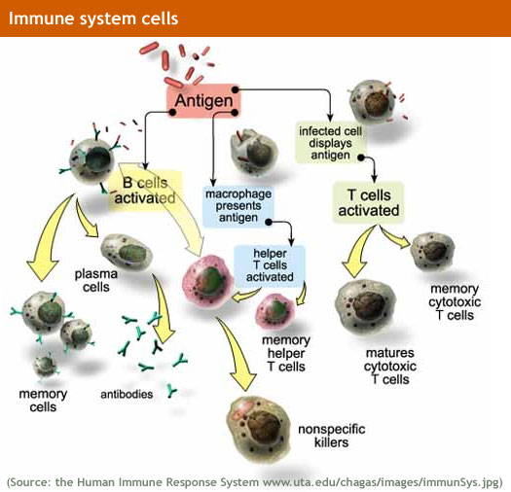
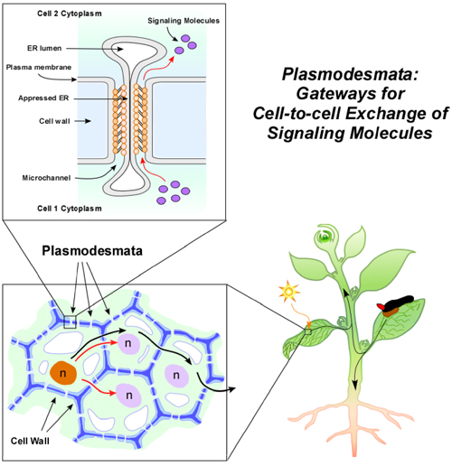
By cell-to-cell contact…
Both animals and plants have cell junctions that, where present, directly connect the cytoplasms of adjacent cells allowing signaling substances to pass freely.
  Plasmodesmata between plant cells that allow material to be transported from cell to cell.
Two cells in an animal may communicate by interactions between molecules protruding from their surfaces.
  Immune cells interact by cell-cell contact, antigen presenting cells, helper T-cells and killer T-cells

Slide 7
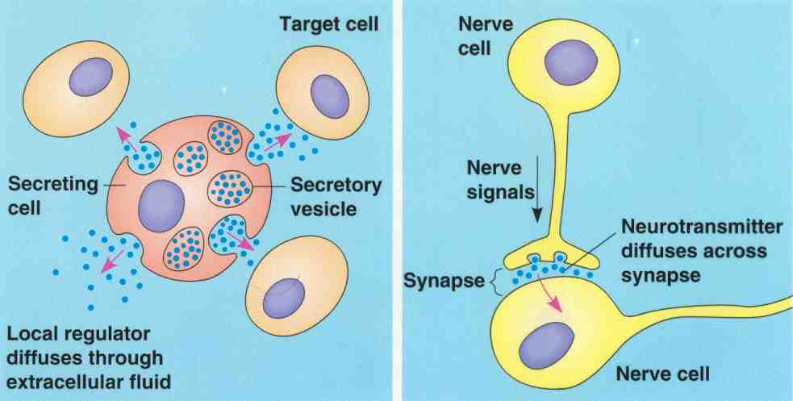
Over short distance by using local regulators…
Used by cells to communicate to their immediate neighbors
One cell secretes a signal molecule into the extracellular fluid or in the vicinity of the emitting cell, which is picked up by the target cells
  Neurotransmitters
  Plant Immune response
  Morphogens in embryonic development

Slide 8
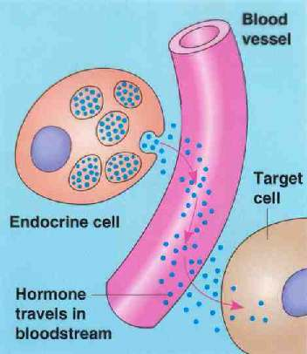
Over long distances to target cells of another cell type…
Endocrine signals are produced by endocrine cells that release signaling molecules, which are specific and can travel long distances through the blood to reach all parts of the body
The signal molecules travels throughout the body, most likely contacting nearly all cells in the organism
Only the target cells, however, will have the receptors necessary to elicit the response
  Insulin
  Human Growth hormone
  Thyroid hormones
  Testosterone
  Estrogen

Slide 9
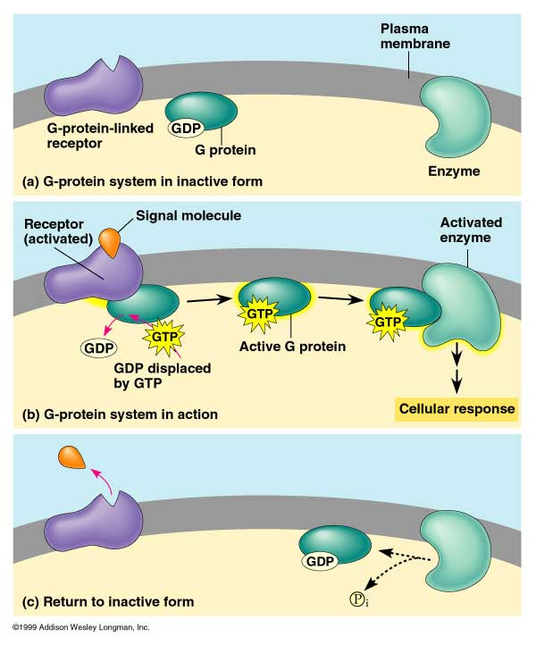
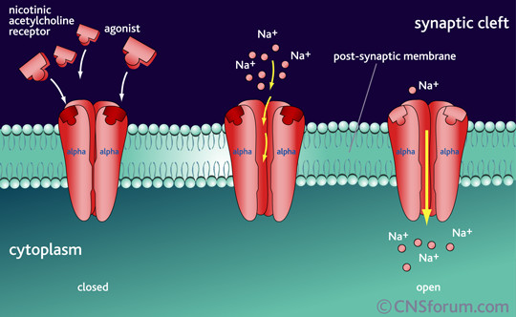
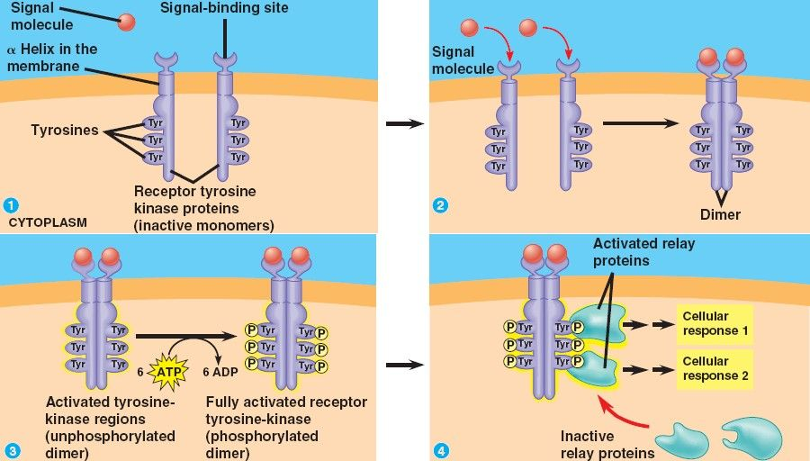
Signal Transduction Pathway
The process by which a signal on a cell’s surface is converted to a specific cellular response in a series of steps.
Signaling begins with the recognition of a chemical messenger, a ligand, by a receptor protein
  Different receptors recognize different chemical messengers, which can bee peptides, small chemicals or proteins, in a specific one to one relationship
  A receptor protein recognizes signal molecules, causing the receptor protein’s shape to change, which initiates transduction of the signal
    G-protein linked receptors
    Ligand-gated ion channels
    Receptor tyrosine kinases

Slide 10
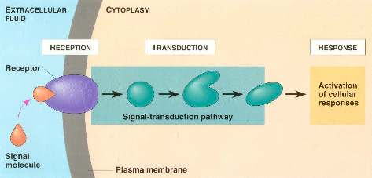
Signal transduction is the process by which a signal is converted to a cellular response.
  Signaling cascades relay signals from receptors to cell targets, often amplifying the incoming signals, with the result of appropriate responses by the cell.
  Second messengers are often essential to the function of the cascade.

Slide 11
Many signal transduction pathways include:
  Protein modifications
  Phosphorylation cascades in which a series of protein kinases add a phosphate group to the next protein in the cascade sequence.

Slide 12
Conditions where signal transduction is blocked or defective can be
  deleterious,
  preventative
  prophylactic.

